Slide 1



Company Presentation
Trimester 1 - 2023
Notes:
Gopher Industries develops practical software applications to solve problems in the healthcare sector using current state-of-the-art solutions in artificial intelligence (AI), Internet of Things (IoT) and wearable technology to develop solutions that enables to build healthier communities and provide people with better medical care.

Slide 2





About Us
Deakin’s Healthcare-Technology company
Provides healthcare solutions through state of the art technology
Enhances Community health through technology
Realtime health monitoring through IoT, AI & wearable technology
Notes:
Gopher Industries develops practical software applications to solve problems in the healthcare sector using current state-of-the-art solutions in artificial intelligence (AI), Internet of Things (IoT) and wearable technology to develop solutions that enables to build healthier communities and provide people with better medical care.

Slide 3
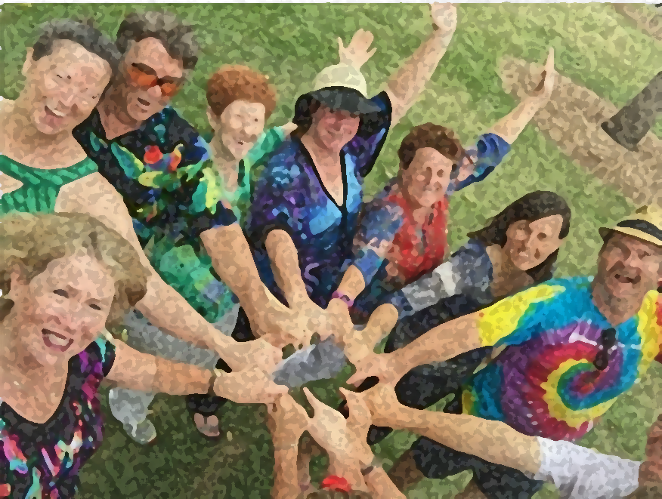
Our Vision
“To build healthier communities
through enabling technologies”
Notes:
Our vision is to build healthier communities through enabling technologies.

Slide 4


Our Mission
“To develop innovative products to monitor, diagnose and manage health and well-being using state-of-the-art wearable technology, IoT and AI solutions to improve people's health and enable better access to healthcare”
Notes:
Our mission is to innovate products to monitor, diagnose and manage health and well being, using state-of-the-art wearable solutions. This will enable patients to better to healthcare and improve their overall health.

Slide 5
Delivery Methodology
We deliver our work through Agile
Think Agile….
Work Agile….
Notes:
Gopher industries promotes agile/scrum delivery methodology – all our 6 projects teams aim for 2 week sprints and planning to deliver the projects work through 3-4 sprints in Trimester 1 2023

Slide 6
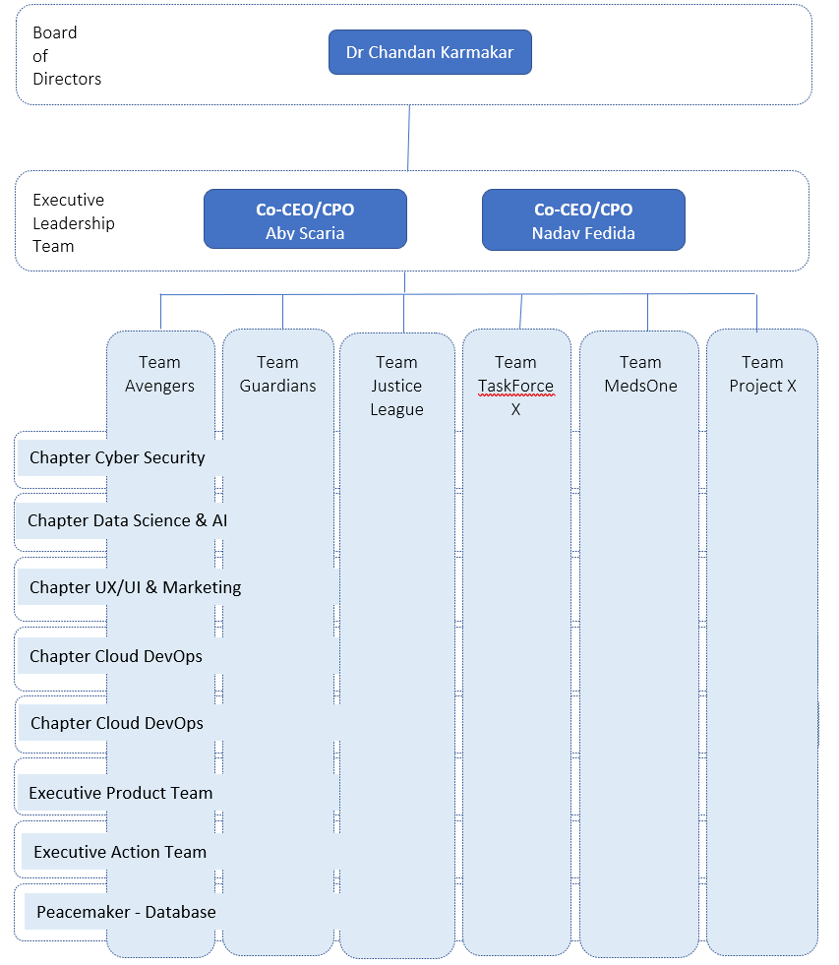
Company Structure
Notes:
We have an industry style organisation structure . Our director is Dr Chandan Karmakar , we have 2 Executive team members – Aby Scaria and Nadav Fedida sharing CEO and CPO roles. They both mentor 3 project team each as shown in the org chart. We also have some cohorts in parallel that provide expertise to the project teams and help them to deliver better. This time we also promoting a team called peacemaker they primarily look into the database end for all of the project teams and there will be a member from each project team supporting this initiative.

Slide 7
T1/T2 - Active Projects
TEAM GUARDIANS
Activity Monitoring & Profiling App
Team Guardians aims to provide state of the art services as an integrated smart health care system (“Guardian”) to facilitate real time patient activity monitoring via modern Radar sensors that are connected through IoT service to a mobile app. (Team Mentor – Aby Scaria)
TEAM AVENGERS
Chatboat System for Remote Health Monitoring
The Gopher Industries Chatbot, also known as “Medi”, aims to simplify the process of information gathering and retrieval by providing a unified conversational interface for patients and health practitioners to enter and review data. (Team Mentor: Aby Scaria)
TEAM JUSTICE LEAGUE
Monitoring Pain or Discomfort in non-verbal patients
The objective of developing this product is to improve patient care by developing a tool for healthcare providers to increase diagnostic accuracy. (Team Mentor : Nadav Fedida)
TEAM TASK FORCE X
Nutritional Health Application
NutriHelp aims to promote healthy eating habits for Australia's senior population, by providing personalised recipes based on the user's specified health conditions and nutritional preferences. (Team Mentor : : Nadav Fedida)
TEAM PROJECT X
Company Website
Project X is a team where a group of Gopher Industries members come together with the aim to develop and maintain the Gopher Industries website. The website provides information about Gopher Industries activities and provides an overview of the six products current progress by providing link to each product. (Team Mentor : Aby Scaria)
TEAM MedsOne
E-Prescription Application
MedsOne project . Application to monitor and compare medicine. Once the platform is complete, users will be able to get medicine delivered to their homes, scan different medicines and get all the relative information about them (Team Mentor : Nadav Fedida)
Notes:
We currently have 6 active projects,
Team Guardians – A monitoring and profiling application
Team Avengers – A chatbot system for remote health monitoring
Team Justice League – Monitoring pain and or discomfort in non-verbal patients
Team Task Force X – A nutritional health application
Team Project X – A company wide website showcasing all projects.
Team MedsOne – An Electronic prescriptions application.

Slide 8
T1/T2 - Projects on Hold
TEAM ETERNALS
Medication Management & Reminder App
The primary goal of MediMind is to help older people follow their customized medication schedules. In order to improve user autonomy and confidence in managing their health, improve health outcomes, and reduce exacerbations or relapses necessitating medical intervention,
TEAM PEACEMAKER
Centralized Database and Core Services
The goal of Team Peacemaker is to provide the Apollo Database to host and integrate Gopher Industries’ product suite, centrally manage patient history, provide core services company-wide and eventually enable artificial intelligence data analytics on patient data.
Notes:
Aside from our active projects, we have 2 addition projects which are currently on hold.
Team Eternals – The medication management and reminder application.
Team Pacemaker – The centralised database and core services.

Slide 9
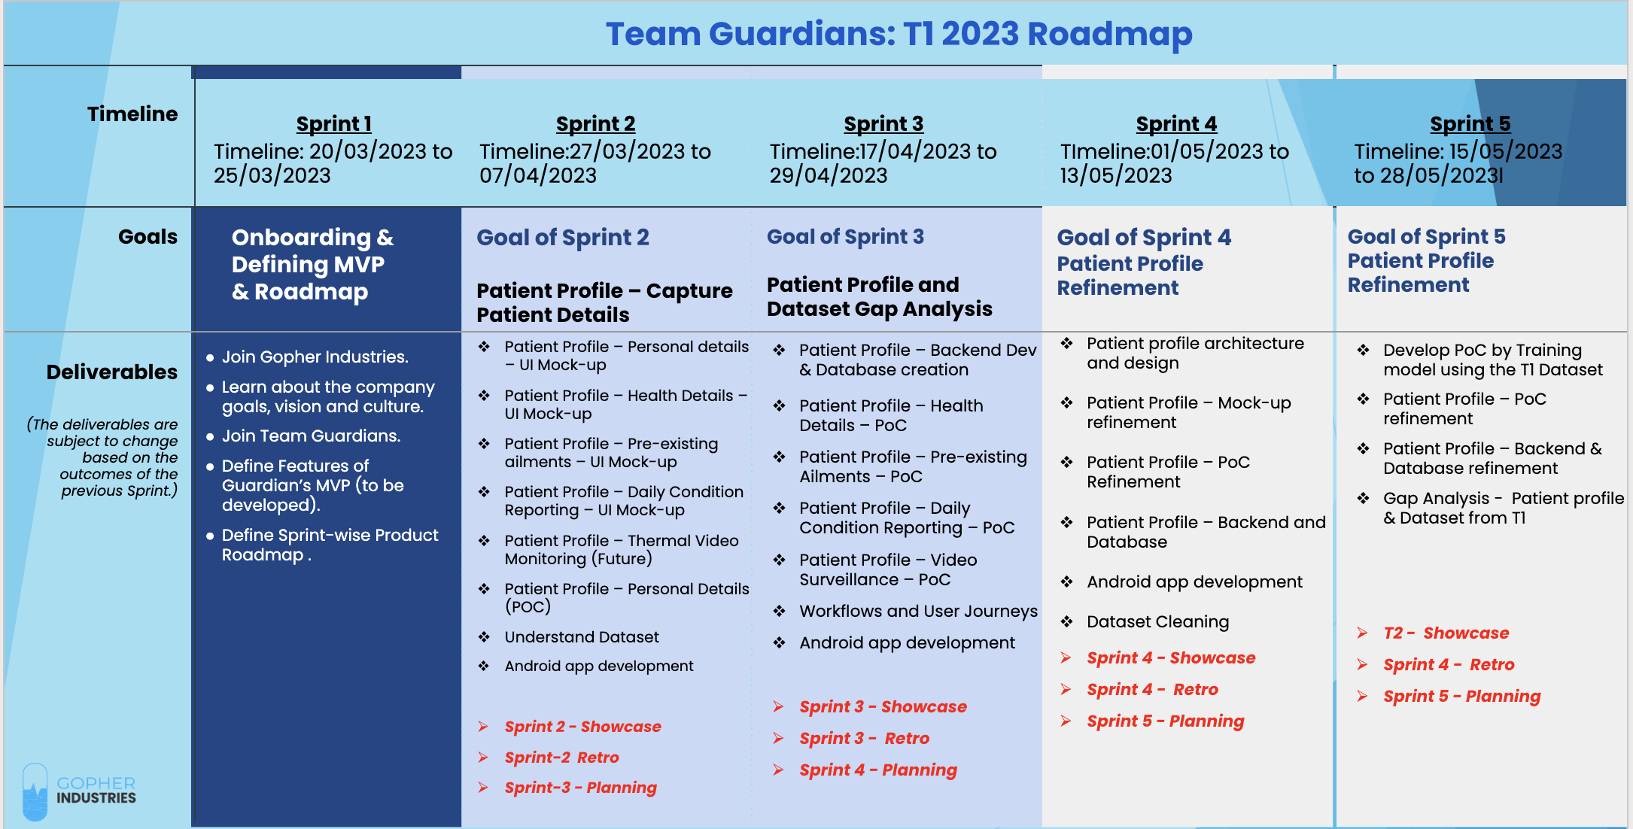
Team Guardians
Team Mentor : Aby Scaria
Notes:
Team Guardians – developing a product suite called Guardians
The high-level MVP consists of – Patient Profile capture and daily reporting, Activity monitoring through radar device to report any abnormal behaviours detected through data analytics and machine learning component

Slide 10
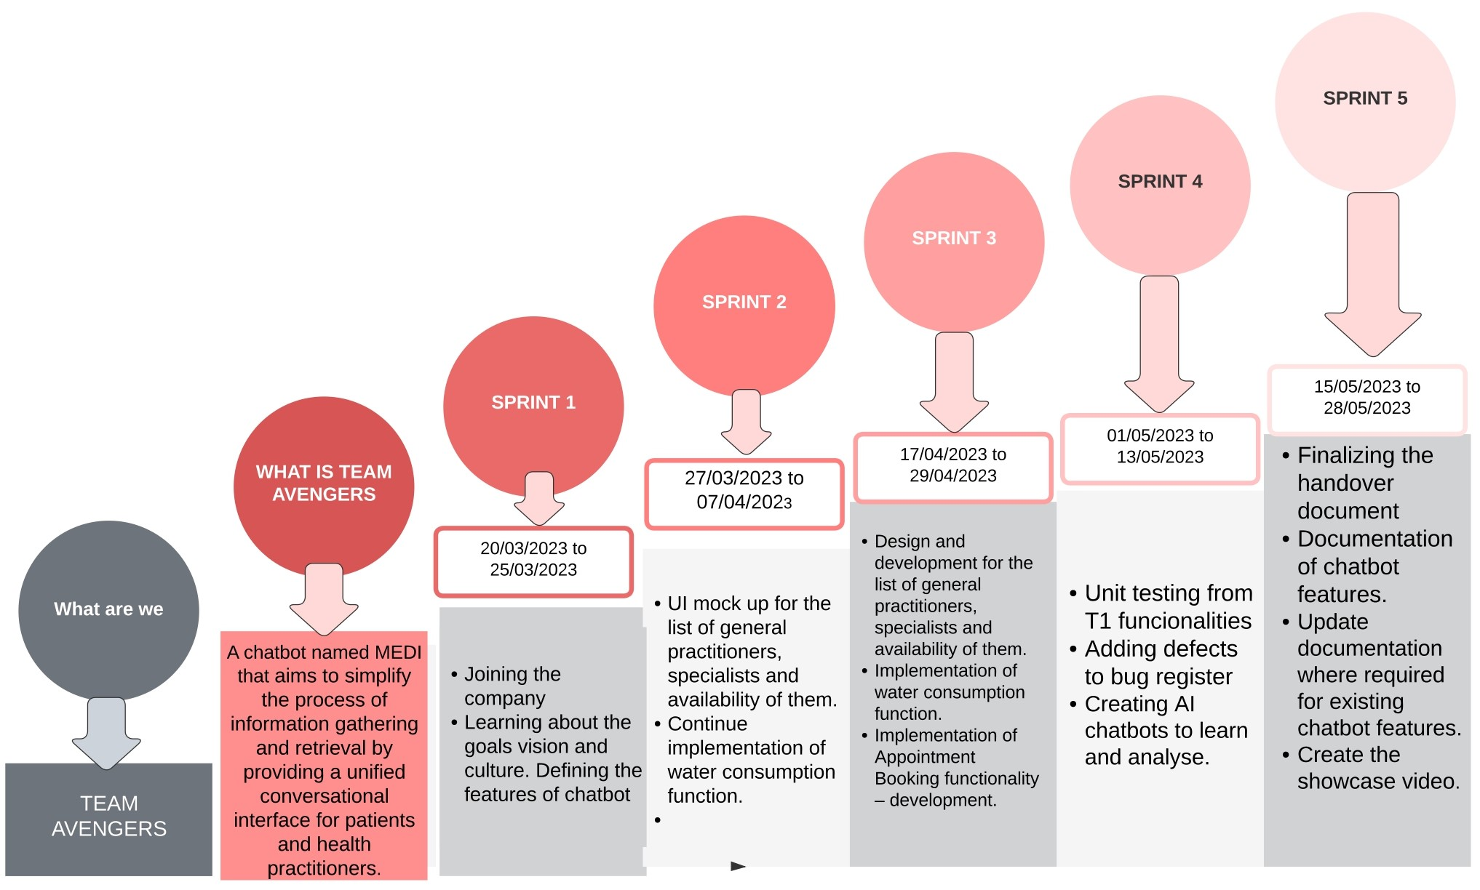
Team Avengers
Team Mentor – Aby Scaria
Notes:
Team Avengers are in the process of developing the chatboat system called - Medi High-level MVP are UI mockup for list of GPs , continue implementation of water consumption function, implementation of appointment booking function

Slide 11
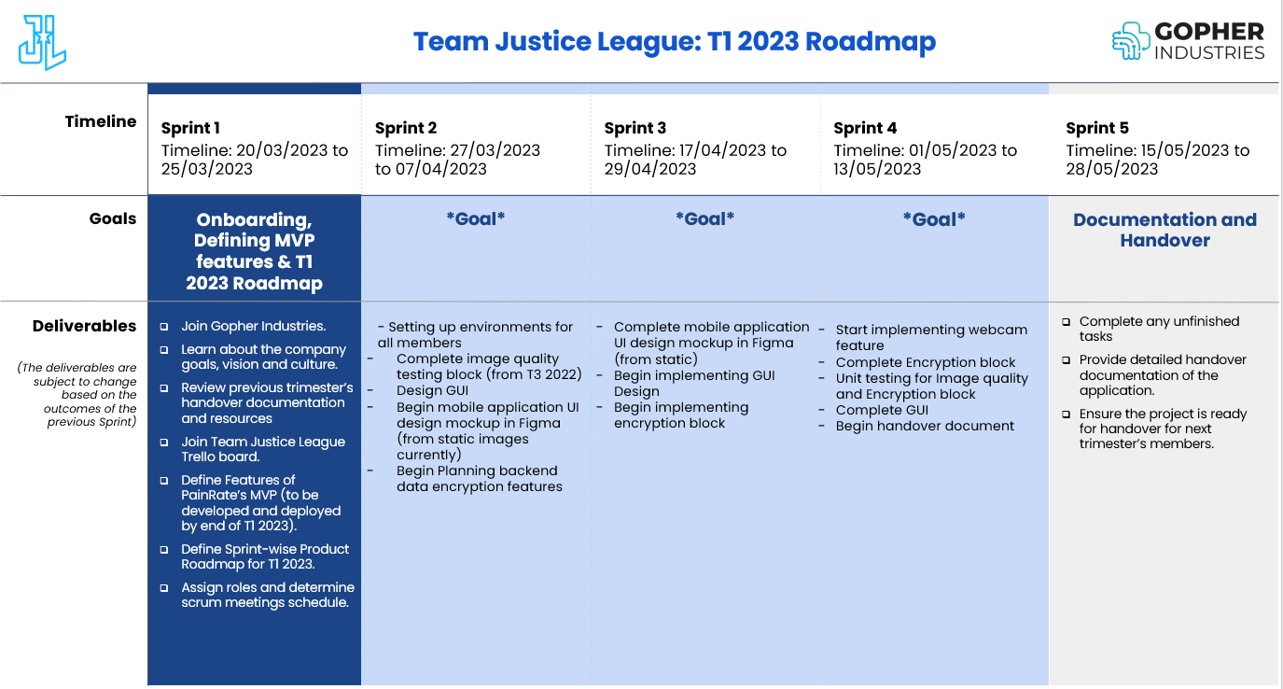
Team Justice League
Team Mentor : Nadav Fedida
Notes:
Via the application we are creating, we will be able to provide health physicians a more accurate way to monitor and detect pain in non-verbal patients.
Using our machine learning algorithms, the application will return a simplistic yet accurate numeric value of pain to better express the patients struggles.

Slide 12
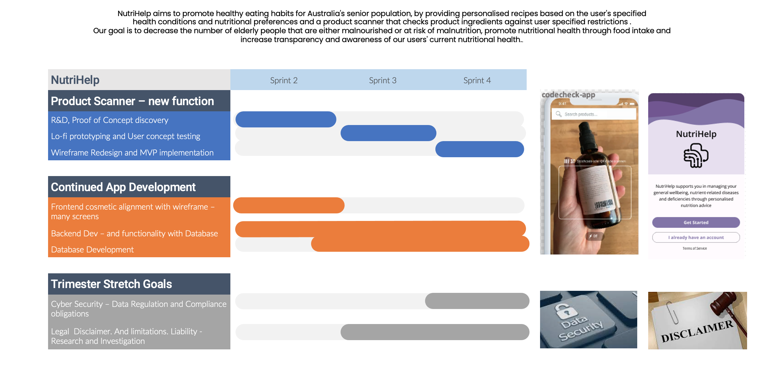
Team Task Force X
Team Mentor : Aby Scaria
Notes:
This trimester we’ll be looking at prototyping a product scanner to use with our application. The idea is to use this feature to enable users to take a photo of a product and retrieve information on its ingredient. This information is then used to filter out user preferences and alert them to any harmful constituents.

Slide 13




Team Project X
Team Mentor : Nadav Fedida
Sprint 2
27/03/2023 07/04/2023
Sprint 3
17/04/2023 29/04/2023
Sprint 4
01/05/2023 13/05/2023
Sprint 5
15/05/2023 28/05/2023
Team Members
Development Environment Setup
Detailed review of Current Project
Initial UI/UX Designs for responsive layout
Juniors: upskill if needed
Site Redesign to incorporate responsive styling
Refinement of Figma Designs/Research
Add/update products
Integrate Company Timeline with Backend via API
Integrate Student Timeline with Backend via API
Integrate Chatbot with Backend via API
Corey Bock Scrum Master
Betty Yuliani Product Owner
Harry James UI Designer
Michael Zou Cyber Security
Viseth Kong Full Stack
Denis Kimathi Frontend Developer
Omer Steinberg UI Designer
Mark Dino Business Analyst
Daniel Dobreski Frontend Developer
Handover & Documentation
Frontend
Finalise Code
Complete final Tasks
Complete Handover document
Complete showcase video
Senior handover to Juniors
Development Environment Setup
Detailed review of Current Project
API Integration Plan
Review of Docker
Build microservices into individual docker files
Deploy microservices to GCP
Research and integrate Chatbot with DialogFlow
Expose all microservices APIs and assist FE with integration
Research and plan SSO for next trimester
Backend
Access GCP Project and review permissions
Review required services
Liaise with Deakin IT
Plan architecture
Code Repository Setup
Create required services
Research GCP Products
Investigate domain status and liaise with Unit Chair/Director
Setup FE Pipeline
Setup BE Pipeline
Test Infrastructure
Infrastructure
Notes:
Team Project X – responsible for providing Gopher Industries with an innovative and stylish portfolio based web project to show case the work of the entire company. The high level roadmap for this trimester focuses on implementing a responsive site design for tablets and mobile devices, improved functionality with the timeline modules and updated product information. Other teams in Project X will focus on implementing the backend to support this functionality and hosting infrastructure for the project.
The team consists of a blend of UI Designers, Front and Backend Developers, Cyber Security experts, Solutions architects and business analysts.

Slide 14
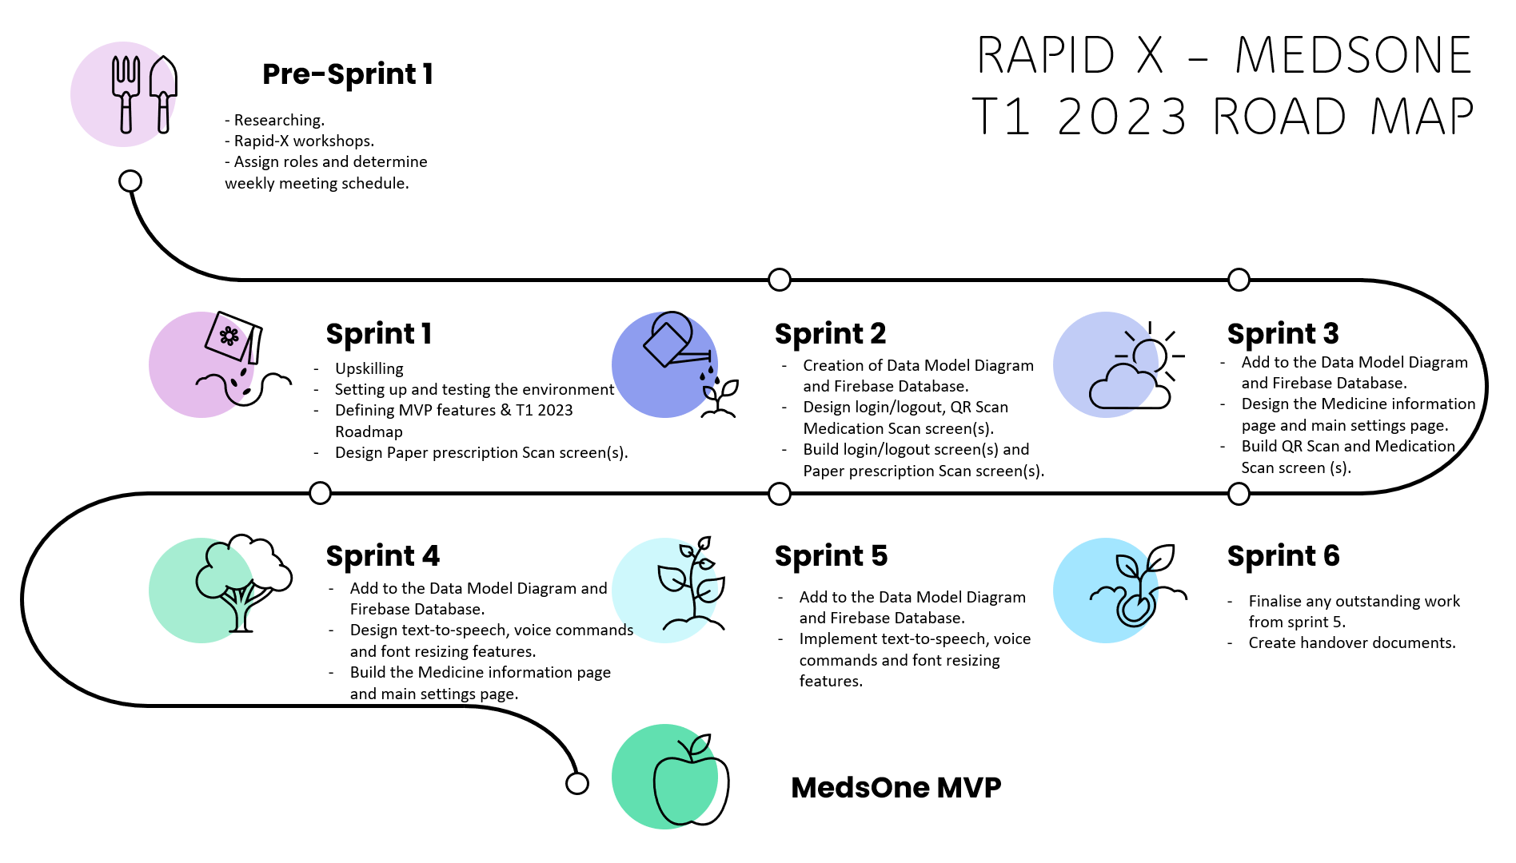
Team MedsOne
Team Mentor: Nadav Fedida
Notes:
MedsOne is an integrated platform for users to order, monitor and compare medicine. Once the platform is complete, users will be able to get medicine delivered to their homes, scan different medicines and get all the relative information about them.
This will create a well rounded application that helps old, disabled and unorginised people, to keeps records of all interactions.
Some additional features are:
Reminders
Digital scripts
Price comparisons for medicine.
Voice commands.

Slide 15
Progress at a glance…
Team allocation - Completed
T1 MVP - Finalized the MVP
T1 Sprint Road Map - Completed
Sprint 1 - Started

Slide 16
Thank you for listening! Any Questions?

